Slide 1

WELCOME
MGMT 8760: Leadership & Management Essentials
MODULE 8: Managerial Communication
Notes:
Title Page

Slide 2
Agenda
2
Explaining The Communication Model
Exploring Communication Channels
Discussing Effective Communication
Inclusive Communication & Leadership Concepts
Notes:
In our last module we discussed how to move from a group to a team. Managing & leading teams can be difficult, specifically if you aren’t moving in the same direction. Effective communication is key to ensuring that team members all know the common purpose, goals and desired outcomes of your team.
In this module we will take a closer look at communication. We will take an evidence-based approach to the components, and how they work together to make communication effective. We will also review how the advent of technology has aided in communicating while at the same time has created new challenges as well.
Finally, we will continue our thoughts on how traditional communication practices differ from ‘inclusive’ approaches by thinking about not just the quality of components of communication but also in using concepts that embrace not only the message but the audience and their different ‘readiness’ to receive the message.

Slide 3
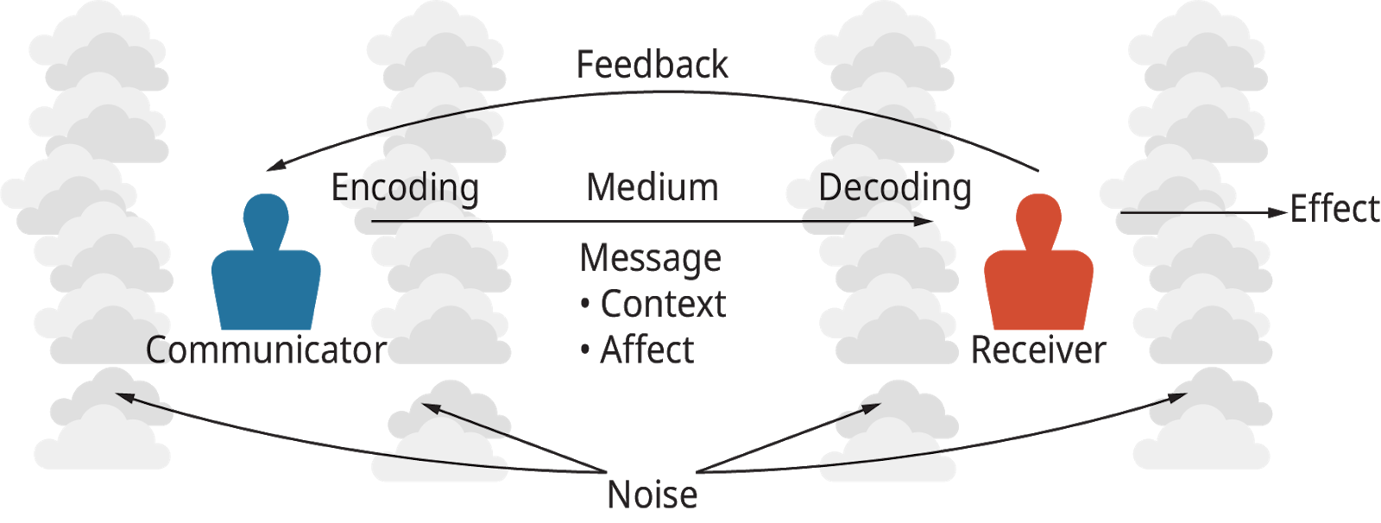
The Communication Model
3
The Basic Communication Model (Attribution: Copyright Rice University, OpenStax, under CC-BY 4.0 license)
Notes:
Like most concepts we have learned in the course, we can break communication down into the sum of its parts.
As you see in the figure in the slide, we can think of communication from the position of the sender & the receiver.
The sender chooses a medium, such as speaking or writing to ‘encode’ a message to either an individual receiver or multiple people at the same time. The receiver ‘decodes’ the message in some way and through their actions or feedback to the ‘encoder’ we can measure how effective the communication is…the problem is that we don’t always ‘decode’ with the same intent as the message was created to imply.
Sometimes, language, competency, interest and many other variables can confuse the message and the outcomes are not what was intended. We call the miscommunication a product of ‘noise’. Noise can be anything that reduces effectiveness from the intended message to the actual outcome.
In organizations, miscommunication or excessive noise can be very costly. So, let’s take a look specifically at communication in organizations. Noise can then be seen as anything that interferes with what the communicator encodes to how the receiver decodes an given message. The better the feedback then the better the opportunity the sender has to correct or eliminate any noise that get’s in the way.

Slide 4
Organization Communication Types
Downward
Communication that flows from one level of a group to a lower level
Managers to employees
Upward
Communication that flows to a higher level of a group
Employees to manager
Becoming increasingly difficult
Lateral
Communication among members of the same work group, or individuals at the same level
(Langton, Robbins & Judge, 2019)
Notes:
A good place to start is to identify different types of communication:
As you can see in the slide, direction has an impact on how both encoders & decoders create and interpret communication.
When we think of leadership, it is normal to think of downward communication or traditionally how superiors filter tasks, commands & direction to subordinates to complete them. We can see the link between position power and measuring productivity. A simple example would be a schedule…a manager posts the schedule and employees show up for their shifts.
Or is a schedule a good example? Let’s take a minute to think about how this may play out in the real world…an associate may go back and communicate upwards to the scheduling manager. Whey, well let’s say the organization has a ‘booking time off’ process. It may be a binder or some online scheduling request where associates book time off. Or perhaps even a manager makes a mistake and schedules someone against their availability. Instead of simply not showing up for their shift, an engaged employee would seek out the manager and ‘communicate’ their error.
Would that be the end of the conversation? Maybe or just maybe not…that same associate may have a conversation with another employee in the lunchroom explaining their frustration or even contempt for the scheduling manager….this is an example of the most common type of communication in organizations, lateral communication.
There is actually a lot to unpack in the examples above that relates to the rest of the module.
What forms or ‘channels’ of communication are used and are they all equally effective across all situations?
What is effective communication? Which type is better and why? What are barriers to effective communication?
Is there the same relationship between traditional & inclusive aspects in communication like we have seen in leadership styles & attributes?

Slide 5
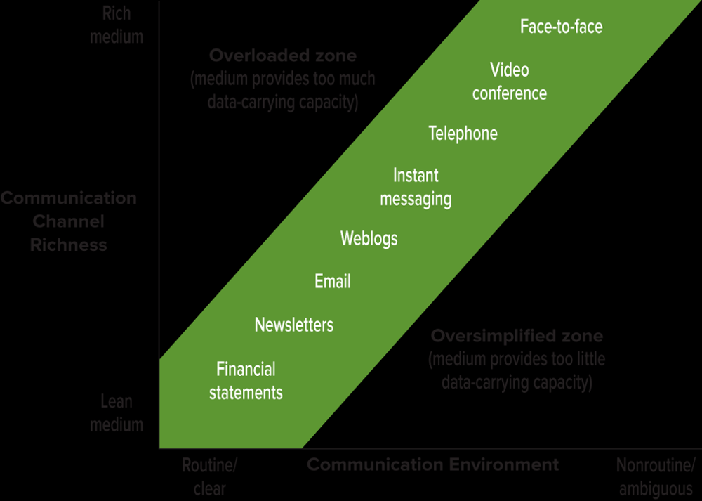
Communication Channels
5
Media Richness:
The channel’s data-carrying capacity needs to be aligned with the communication activity
High richness when channel:
Conveys multiple cues
Allows timely feedback
Allows customized message
Permits complex symbols
Use rich communication media when the situation is nonroutine and ambiguous
(McShane, Steen & Tasa, 2019)
Notes:
We finished the last slide with some questions, the first of which related to to what ‘channels’ or modes if you like are used in organizational communication.
In the slide above you can see that there are different media in which we communicate from face to face in the same room to publishing reports. A good way to look at communication channels is to think about the cost involved in encoding and decoding the message.
If we review the communication model we know that the sender chooses the medium in which to communicate. Choosing the appropriate medium helps reduce the amount of noise. If you look in the figure on the right you will notice that we have another interaction that can help us determine the appropriate channel when communicating. There is a trade off or concession that no one channel is ideal across all situations. We need to consider ‘richness’ which means the media’s cost with the situation or environment in which the receiver obtains the message. For example ‘face to face’ communication is considered the most expensive or ‘rich’ form of communication. There are costs associated with having one on one communication in the same place. In fact it is impossible for organizations to only run on this one channel as it would slow productivity to a crawl.
However, there are other reasons that face to face communication is also inadequate and I will prove it by using an old training game I have used for years. In fact, this game was introduced to me when I was a child away at summer camp. It is called telephone and it works like this. You have a group of people, say 10 or so and you have one person memorize a story and whisper it into the ear of the first person. The second person then whispers it to the next, and so on until you reach the last person who has to re-tell the story out loud. If any of you have ever played this game you may remember that the final story is often very different to the version, usually if played well to hilarious results.
So why is this relevant? Well, telephone is actually face to face communication, it is in the same environment and only between two people. Now there are other forms of face to face communication that involve more than two people, meetings as an example. If we were to tell the story to all 10 people at once, it wouldn’t only be ‘cheaper’ it would actually reduce ambiguity or ‘noise’ in the retelling of the initial story vs individual variations of it. Choosing the appropriate media may seem like common sense but we will see if that is the case as we start to look at the other questions we proposed in the last slide.
Here is a link to a funny game of telephone that starts with someone acting ‘angry’ and it turns into something quite different: https://www.youtube.com/watch?v=L-hO3AggDr0

Slide 6
Considering The Situation: Daily Communication
6
One-on-One Conversations
Telephone Conversations
Video Teleconferencing
Presentations to Small Groups
Public Speaking to Larger Audiences
Social media!
(Bright & Cortes, 2019)
(McShane, Steen & Tasa, 2019)
Notes:
Ok, so we now we can look at how different types of organizational communication relate to media richness. What you see on the left are common media in which organizations use to communicate. You will notice a blend of traditional methods but we have seen a dramatic shift in the workplace to rely on technology. You may find this hard to believe but it wasn’t actually all that long ago that email wasn’t possible in the workplace as an example and it is now the most common communication tool used not only at work but in our personal lives as well. Or at least some iteration of sending written communication using technology as the platform.
All media work across the 3 types of organizational communication (downwards, upwards & lateral) but are we actually choosing the right media to benefit our cost as well as considering the situation?
Let’s take a look at different types of electronic communication and assess whether we are communication better with technology or not…

Slide 7
Electronic Communication
7
Email:
Corporate employees send and receive an average of 105 emails each day
Many managers report spending too much time on email
Corporations lose $650 billion each year from time spent in processing unnecessary emails
Privacy concerns
Instant Messaging
Usually done via computer
Synchronous technology – you have to be there to receive the message and respond
Texting
Usually done via cellphone
Also synchronous technology, although the text message will be stored (like email) until read
Social Media:
Nowhere has communication been more transformed than in social networking
Social media platforms
Facebook
LinkedIn
Zoom
Google+
Other Apps
Blogs
Website about a single person or company that is usually updated daily or quite frequently
Most blogs are written by individuals, but many organizations and organizational leaders have blogs that speak for the organization
Twitter is a hybrid social networking service for users to post “micro-blog” entries
(McShane, Steen & Tasa, 2019)
Notes:
Let’s start with email. In the box on the left we see exactly how popular email has become. Not only as a communication device but in how we plan and organize our day as well as how others use it to potentially market, brand or even annoy. We have built a platform and even a business that protects us from downloading harmful emails as well as policies and procedures for what each organization deems as ‘appropriate’ use of individual email accounts.
So why is a system that is so full of potential problems so popular…in a word, cost! Think about the number of recipients you can reach, the efficiency and relative ease of use and it requires little in the way of additional labour compared to how we would send individual and mass messages before email was created. (Although I do have a few friends in IT who may argue it’s ease of use based on the conversations they have using more traditional methods when email goes wrong!)
Email has become so popular that you can see we are even ok or at least accept the waste of $650 billion per year due to using it wrong.
Email became the catalyst for using electronic medium in different ways to change organizational communication and basically in how all companies conduct day to day, long term planning and even bringing of products and services to market. This includes commerce, not for profit, private and public institutions. All you need to do is consider how marketing has evolved due to technology in the past 20 years and you will hear the ‘path to the consumer’ is more divergent than ever before. Review the different boxes above and you will see how different electronic mediums have altered how we communicate. In fact our smart phones are rarely used as phones at all anymore, instead they have become devices that allow us to encode and decode electronic messages while no longer be chained to a single environment such as a desk or office.
So why does this matter in a leadership course? Well we need to consider the communication model and the popularity and intent of using electronic media, specifically email. There is a culture in sending email that also promotes accountability. You can get read receipts and forward or copy messages that prove you have completed or attempted to communicate with others. This is often referred to in Canadian organizations as ‘covering your ass’ or CYA communication. Instead of thinking about the appropriate balance between cost and environment the sender simply is more worried about ensuring they are protected against reprisals…as you can imagine this could increase ‘noise’ in the message and potentially explain why we are spending such a large amount of money in and creating ‘barriers’ to effective communication.

Slide 8
Barriers To Effective Communication
8
Filtering
The sender manipulates information so that it will be seen more favourably by the receiver.
Selective Perception
The receiver selectively sees and hears based on their needs, motivations, experience, background, and other personal characteristics.
Information Overload
Occurs when the information we have to work with exceeds our processing capacity
With emails, phone calls, faxes, meetings, and the need to keep current in one’s field, more employees are suffering from too much information
Emotions
Individuals may interpret the same message differently when you are angry or distraught than when you are happy
Depression will most likely hinder effective communication
(Langton, Robbins & Judge, 2019)
Notes:
Whether we use electronic or more traditional forms of communication there are tendencies we all have in our behaviour/personality and mental models that make choosing the right medium important in reducing noise.
In the slide above you see some of the human tendencies that can make communicating problematic. In fact over the next few slides we will review different aspects such as who we are, where and when we were born as well as social context in determining why noise so easily can infiltrate the most basic of communication.
It all starts with how we are made. Communication is such a large part of what makes us human that many areas of our brain are responsible for not only what we say but how we say it as well. The left side of your brain contains two areas called Broca’s & Wernicke’s area:
Broca’s Area: responsible for speech production and articulation
Wernicke’s Area: responsible for comprehension
Both areas are responsible for creating sensical speech and written communication.
https://memory.ucsf.edu/symptoms/speech-language
You also have a very active right side of your brain too, areas in the right side are committed to adding emotional content or what is known as the prosodic center for communication. The prosodic areas of the brain are responsible for what we consider normal variation in rhythm, pitch and stress in our voices. Obviously items that rely more on environments that lend to easier interpretation of these factors. Such as being in the same room or on the phone vs over email.
https://dictionary.apa.org/aprosody
Now let’s reflect back to Module 5 when we discussed how all of our mental models and systems ways of thinking may differ. This starts to ezplain why barriers like those listed above can confuse decoding the message and introduce noise. Specifically when we use some channels such as email which can be rich in left brain thinking but maybe are missing some of the prosodic cues that would reduce noise for the receiver…even though we do try, just think of emojis!

Slide 9
Barriers To Effective Communication (continued)
9
Language
Words mean different things to different people
Age and context are the two biggest factors that influence such differences
Silence
Defined as an absence of speech or noise
Not necessarily inaction—can convey:
Thinking or contemplating a response to a question
Anxiety about speaking
Agreement, dissent, frustration, or anger
Lying
Outright misrepresentation of information
Deliberately withholding information
People are more comfortable lying over the phone than face-to-face
Most people are not very good at detecting deception in others
(Langton, Robbins & Judge, 2019)
Notes:
We can categorize some of these barriers and in doing so we can establish some good practices in which to consider using the right media and context in messages we send out. It is also important to consider feedback as an important part of effective leadership communication.
My dad had an old saying…’You have two ears & one mouth, do the math’. I actually have that on a coffee mug that I use to remember that we should listen when talking with others instead of just talking. Email can again introduce problems with feedback that it can become time draining to wait for responses or even wanting too…
In the examples above we can see how issues like Language, silence & yup lying can hinder feedback. For example when I teach face to face in class I am more likely to allow silence to occur. I can get other types of non verbal cues to see if students are being quiet due to thinking or collaborating vs online where in most cases I am starting at black screens with student names on little black boxes (Zoom). I actively ask and encourage students to join with cameras to help me gauge interest and provide me with feedback which allows me to alter my own behaviour…the astute in you may recognize this as a matter of Emotional Intelligence. I am looking to get social cues to regulate my own behaviour.
In not having those cues I look to try different approaches to ‘engaging’ students when we meet online. Asking questions or volunteers to contribute to the discussion as an example. This only works if my patience (not a strength according to my MBTI results) allows for me to accept silence.
Lying is the most problematic of the feedback barriers however, and once again it is due to how most of our mental models work. Specifically for two reasons.
We overestimate our ability to detect when others lie to us. We simply are not as good at detecting lies as we think we are.
Some people are really good at it. The more skill the lie the more likely we are to accept it and in doing so never uncover the real issue of the undesirable effects of our attempts at communicating effectively.

Slide 10
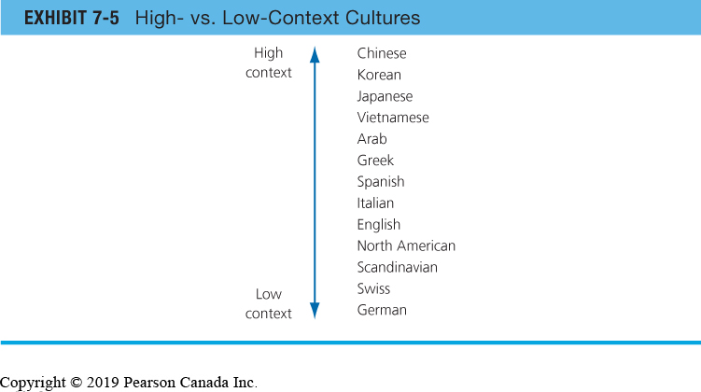
Cultural Barriers to Effective Communication
10
Sources of barriers:
Semantics
Word connotations
Tone differences
Differences in tolerance for conflict and methods for resolving conflicts
Cultural Context:
Cultural differences in what is actually said or written vs who the other person is
High-context cultures
Cultures that rely heavily on nonverbal and subtle situational cues in communication
Low-context cultures
Cultures that rely heavily on words to convey meaning in communication.
(Langton, Robbins & Judge, 2019)
Notes:
Our final category of barriers to effective communication can be thought of as common learned behaviour. In many ways where we come from or when we are born are unique & recognizable. This can mean that you may interpret what others are communicating in a way that isn’t what is intended specifically if the encoder isn’t aware of the cultural differences.
The slide indicates that based on geographic location that we may interpret how other’s communicate in different ways. As we will see later in the course it is more complicated than that but we can also say with certainty that cultural aspects definitely can create noise if they aren’t considered in our communication model.
For example, Conestoga encourages teachers not to use idioms when teaching students, not only international students but even students who share a similar country or region of origin may not understand some idioms as they can be more likely associated with some generations more than others.
Definition of an Idiom: a form of a language that is spoken in a particular area or group that uses some of its own words, grammar, and pronunciations to create a meaning that is more than just the literal use of words. (https://www.merriam-webster.com/dictionary/idiom)
For example, I am a sports fan and like you use sports idioms. However, different sports are very regional and don’t have the same appeal from generation to generation. The sport of boxing as an example differs in popularity around the globe and has become less popular with younger fans than the more popular MMA style of fighting. Well if I am not careful I may use terms associated with boxing or other sports that have made their way into everyday communication that many of my peers and networks understand.
A very popular sports idiom is based on the game of baseball, specifically related to a type of ‘hit’ that a batter can perform during a game called a ‘homerun’. A homerun is when a batter hits the ball out of the field of play in fair territory and is considered the ‘best’ hit as you get to round all of the bases and automatically score a run for your team. If any other team member is on base as well they score as well so it is a great thing for a team who is batting. In fact due to it being hit out of the field of play, a homerun is also known as ‘hitting it out of the park’. This term has been adopted in North American vernacular as a synonym for doing a great job. For example, saying to a colleague, ‘you hit that out of the park’ when they have done a great job in presenting their work to others would be considered a great compliment. Now let’s assume that other cultures like baseball. If not careful I may think that a Japanese or Korean colleague, two countries which baseball is very popular, may understand my idiom. This could be mistaken as it may not mean the idiom has made its way to popular culture as it has in Canada.
This slide shows that if you know more about other cultures (a concept called ethnorelativism) you would be more likely to avoid idioms or be sure to explain them to educate others.

Slide 11
Inclusive Communication
11
When leaders commit to building an inclusive organization, they tend to start with the company mission, vision, values, and a promise to ensure everyone in the organization has a voice. But if they don’t change the way they communicate every day with their employees, leaders are missing a crucial piece. (Zanden & Shalett, 2020)
https://hbr.org/2020/11/what-inclusive-leaders-sounds-like
Notes:
We have spent some time identifying what channels to consider and thinking about barriers to effective communication but is there something we can think of about how to communicate differently? We did have a third question to answer however…
3. Is there the same relationship between traditional & inclusive aspects in communication like we have seen in leadership styles & attributes?
For this week you were to watch the video from Ametros that introduces the concepts of Inclusive Leadership. Simply put, as we have discussed already, inclusive leaders create environments that ‘include’ contributions from everyone. In doing so, input given and received (either through encoding or in feedback) is more likely to include novel solutions to complex problems.
So how do inclusive leaders communicate? Well that’s what you are going to do in the simulation, use the concepts of inclusive leadership in practice to try and fix your ‘broken’ team.
Take a look at the slide and you will see that inclusive concepts need to be put into practice to be effective. So what does inclusive communication look like?
Let’s explore…

Slide 12
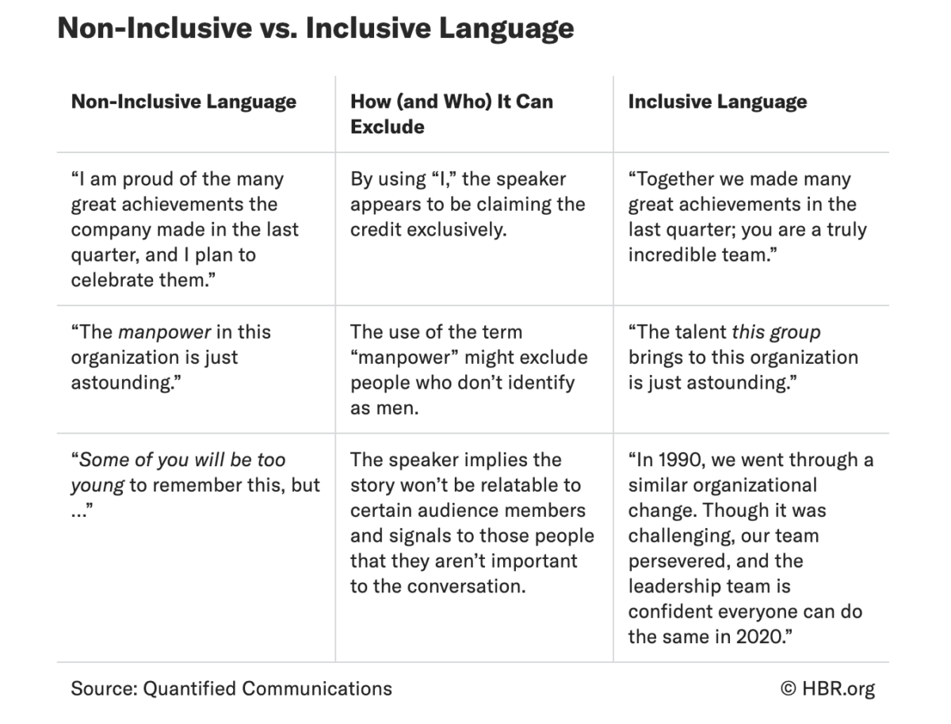
3 Aspects of Inclusive Communication (Zanden & Shalett, 2020)
1. Audience Centered Language
Personalized to your teams
Audience perspective
Similar to you?
Different than you?
Consider their opinions…
Shift from ‘I’ & ‘you’ to ‘we’ & ‘us’
Focus on the team
https://hbr.org/2020/11/what-inclusive-leaders-sounds-like
Notes:
Zanden & Shalett (2020) identify 3 key components or ‘aspects’ of inclusive communication. In other words we can identify and recognize the difference in which inclusive leaders communicate with others vs that of traditional communication approaches.
Take a look at the phrases found on the right side of the slide and you will see how small approaches to identifying that your audience and not you are important when encoding messages. Simply put, changing words like ‘I & you’ to ‘we & us’ can move us away from being interpreted as ‘egocentric’ to considering that your audience has a voice and solicits feedback…including others.
You will get a chance to practice using inclusive terms when communication with your team in the simulation. Just remember that the subordinate’s perspective is important in how they see your leadership ability just like we started discussing back in Module 5.

Slide 13
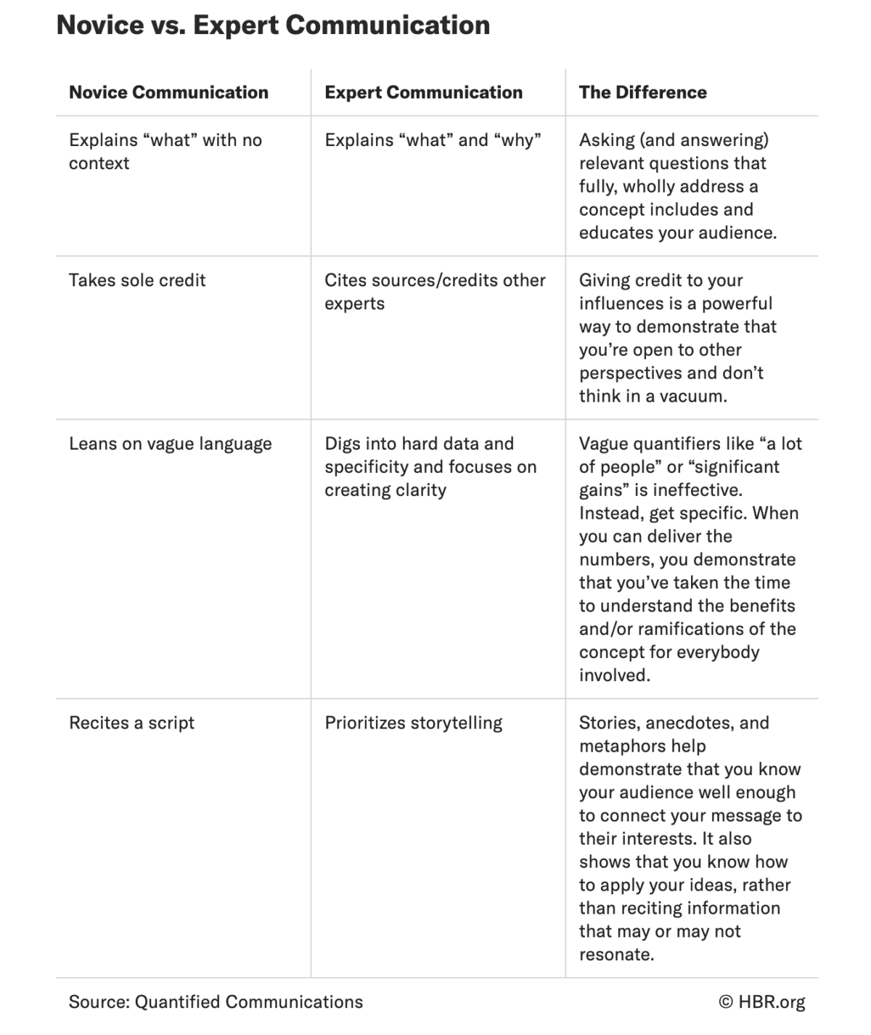
3 Aspects of Inclusive Communication (Zanden & Shalett, 2020)
2. Demonstrating Subject Matter Expertise
Cite & reference others
Communicate complex topics in a relatable way
Use relevant examples
Demonstrate ethno-relative terms
Consider more than one perspective
https://hbr.org/2020/11/what-inclusive-leaders-sounds-like
Notes:
What else matters? Just like Raven & French (1959) told us back in Module 4, being an expert matters too.
Raven & French identified expert power as that which subordinates view the leader to be qualified to lead. Sometimes this means in being able to perform complex tasks or be competent in organizational procedures. Communication is key in being able to demonstrate that competency. In fact if you look at the box above you will see how communication can be a learned skill, that experienced ‘experts’ communicate in demonstrable ways.
For example I used to train salespeople to become good ‘storytellers’. Don’t simply recite or present content in factual way, (left brain) but tap into that prosodic area of your right brain and engage your audience. You can see how then inclusive aspects of subject matter expertise relate to the aspects of referent power in the Raven & French model. Therefore inclusive leaders are more likely to rely on personal power not only in their leadership attributes but in their communication style as well.
So how do you become a storyteller? Well it’s all about practice. Once again we find ourselves potentially looking to technology when communicating. Let’s think about PowerPoint as an example. I often find students have a tendency to read their slides when presenting their contemporary issue findings. Instead think about your audience…Aspect #1: Audience Centred Language and include examples in your presentation. By adding examples, either that you find in the research or from your personal experience starts to show your audience you know what you are talking about and not simply reciting words on a page.
So to summarize…use words like ‘we, us & team’ when communicating with others and demonstrate you can refer to experiences and information to support what you are communicating.
Now you know why it is so important that you know how to cite and reference!

Slide 14
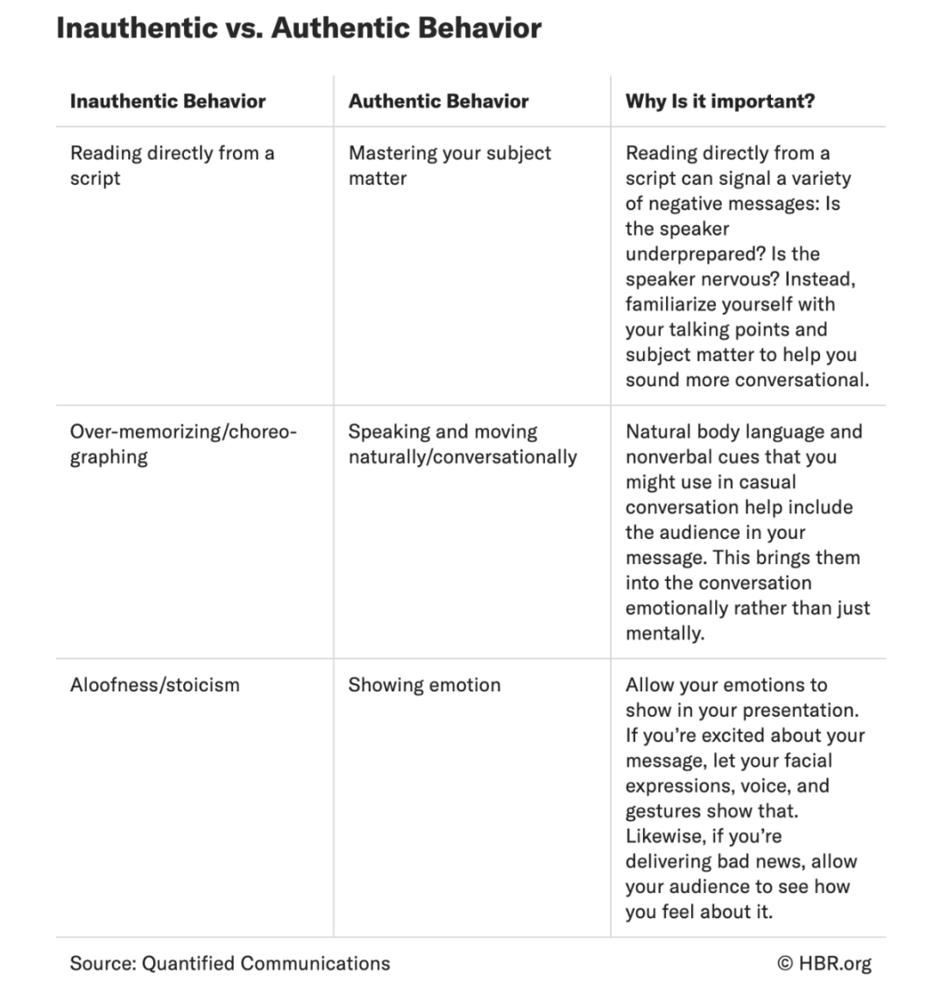
3 Aspects of Inclusive Communication (Zanden & Shalett, 2020)
3. Being Authentic
Be yourself, don’t perform
Talk with your audience instead of speaking to them…
Use words to express NOT impress
https://hbr.org/2020/11/what-inclusive-leaders-sounds-like
Notes:
Finally, be yourself, be authentic.
This should resonate with you as once again we find ourselves referring back to previous module content, in this case specifically Module 6 & the normative approaches.
Look at the examples in the slide and you can see that the best advice I can give you is not to try to impress those with which you communicate but to educate. What is the difference? Well it starts with acting ‘natural’ or in other words act like you would with people you care about. We all are most likely to be our genuine self in situations in which we are comfortable.
“The privilege of a lifetime is to become who you truly are”- Carl Jung.
Your authentic self is who you truly are as a person, regardless of your occupation, regardless of the influence of others, it is an honest representation of you. To be authentic means not caring what others think about you. This may sometimes lead to you standing out from the crowd. (Kelley, 2017)
It starts with being ‘brave’. Take some risks that help you feel more comfortable in demonstrating authenticity. Authentic leadership is one of the characteristics for transformational approaches to changing not only yourself but the environment that encourages others to do so as well. I often start each semester doing things that try to create and atmosphere of encouraging students to be brave, even if it means turning on your video cameras during our time spent online.
According to Zanden & Shalett (2020) adding you to inclusive language and subject matter expertise is more likely to create an environment that encourages others to speak up as well and that improves feedback and drives great solutions to complex problems…a concept called innovation.

Slide 15
Essential Management Communication Skills:
1. Ability to Adapt Your Communication Style
2. Active Listening
3. Transparency
4. Clarity
5. Ability to Ask Open-Ended Questions
6. Empathy
7. Open Body Language
8. Receiving and Implementing Feedback
(Landry, 2019)
Notes:
I am going to finish up this week in providing you with 8 skills that you can apply in your own communication methodology.
Think about each and practice each by monitoring when you are doing or more importantly not doing each (awareness) and creating action oriented strategies to change your own communication competency.
Adapt: Don’t do things the same all the time, just like Hersey & Blanchard (1969) claim in Situational Leadership, be aware of your audience’s readiness level and think about matching your behaviour to their competency.
Active Listening: Paraphrase what other’s say to you. Put your responses in your own words and then listen to see if you got it right. (2 ears & 1 mouth).
Transparency: Be honest, remember your audience thinks you are.
Clarity: Relates not only to expertise but in speaking clearly and confidently.
Ask Open Ended Questions: Avoid ‘yes/no’ questions as they tend to inhibit conversation by minimizing feedback.
Empathy: Speaking of idioms, there is an old English saying that says, ‘learn to walk a mile in another person’s shoes’, which simply means you can see the viewpoint of others. This is key to introducing functional conflict and a great way to do that is to change ‘you & I’ to ‘we & us’.
Open Body Language: Show a genuine interest when culturally relevant use non verbal cues like eye contact and nodding to show you are paying attention to others. Don’t cross your arms (Theory X) which can demonstrate you are closed minded.
Receiving & Implementing Feedback: Be sure to give credit to others not only for great ideas but even in trying. Encourage others to participate by not punishing mistakes but instead teaching other’s to learn from them.
Communication is a key skill for leadership in that we lead others. Humans are social animals and it is in our unique ability to communicate in complex ways that we strive to improve both as individuals and societally as well.

Slide 16
Summary:
Communication is an essential act of leadership in all roles...effective communication includes:
Minimizing Noise
Selecting the Proper Channel
Understanding Other’s
Similarities & Differences
Culture Implications
Inclusive Aspects
Audience Centred
Expert
Authentic
Notes:
Noise is the enemy of effective communication. Unfortunately we sometimes introduce noise in making the wrong choice of what medium we communicate with others. Considering your audience, your own competency and recognizing you can improve your own effective communication style is a fundamental leadership skill.
Be brave, try new things and learn to tell stories to engage your audience and you will be surprised that followers will move away from having to listen to your (Position Power) to wanting to hear what you have to say…

Slide 17
References
Bright, D.H. & Cortez, A.H. (2019). Principles of management
https://openstax.org/books/principles-management
Landry, L. (2019). 8 essential leadership communication skills
https://online.hbs.edu/blog/post/leadership-communication
Langton, Robbins & Judge (2019). Organizational behaviour
Pearson Publishing Canada
McShane, Steen & Tasa (2019). Canadian organizational behaviour (10th Edition)
McGraw Hill Publishing Canada
Zanden, N. & Shalett, L. (2020). What inclusive leaders sound like.
https://hbr.org/2020/11/what-inclusive-leaders-sounds-like

